Slide 1
SEARCH STRATEGIES

Slide 2
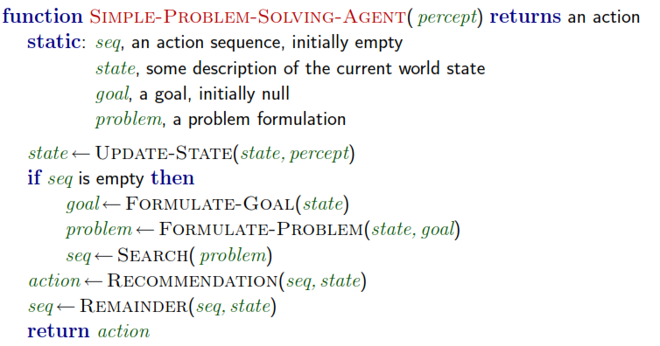
PROBLEM SOLVING AGENTS

Slide 3
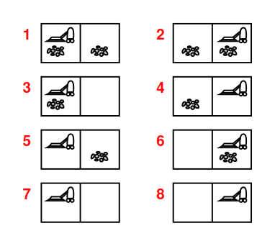
E.g. Vaccuum Cleaner Problem

Slide 4
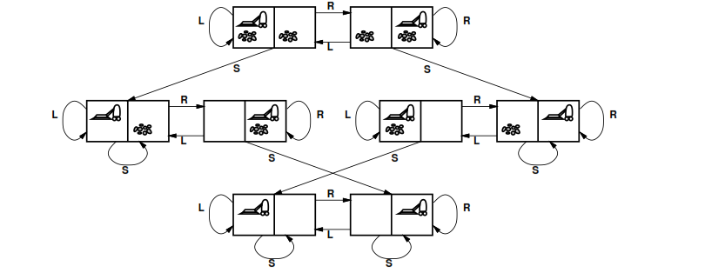
STATE SPACE GRAPH

Slide 5
SEARCHING FOR SOLUTIONS
Check whether it is a goal state. If not
Expand current state
Generate new set of states
Choice of which node to expand – Determined by search strategy
City Search Problem : Explanation
A node is a data structure with five components
State ( State in state space to which node corresponds )
Parent Node ( Node in search tree that generated this node )
Action ( applied to parent to generate node )
Path Cost ( Path from initial state to node )
Depth ( No of steps along path from initial node )

Slide 6
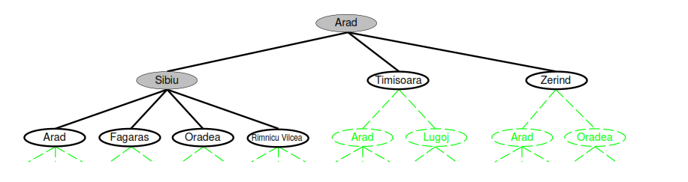
CITY SEARCH PROBLEM

Slide 7
CONCEPTS
Fringe – Collection of nodes generated but not yet expanded
Leaf Node - Each element on the fringe
Due to computationally expensive search strategy, collection of nodes can be implemented as a queue.
Operations on queue :
MAKE-QUEUE(element)
EMPTY?(queue)
FIRST(queue)
REMOVE-FIRST(queue)
INSERT(element, queue)
INSERT-ALL(elements, queue)

Slide 8
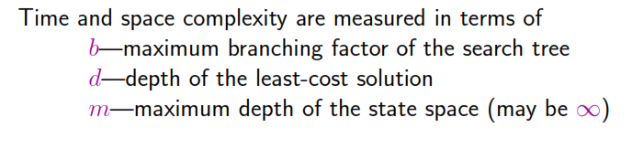
DIMENSIONS ( SEARCH STRATEGIES )
Completeness
Time Complexity
Space Complexity
Optimality

Slide 9
UNINFORMED SEARCH STRATEGIES ( BLIND SEARCH )
Breadth First Search
Uniform Cost Search
Depth First search
Depth Limited Search
Iterative Deepening Search

Slide 10
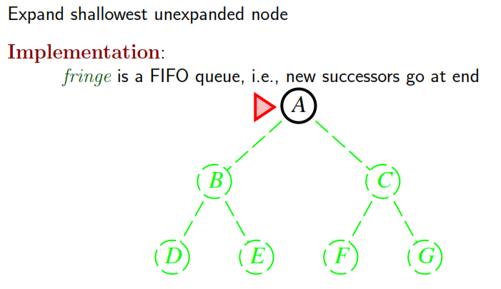
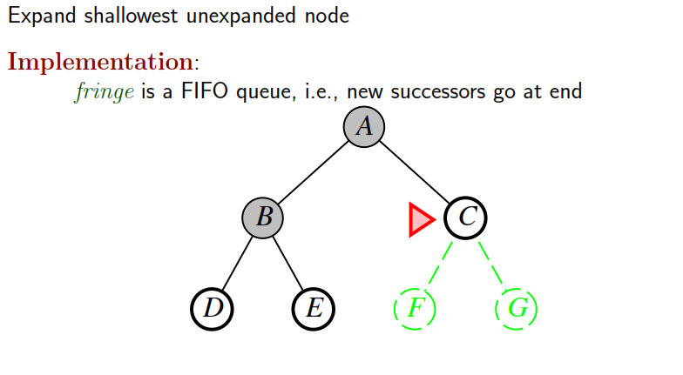
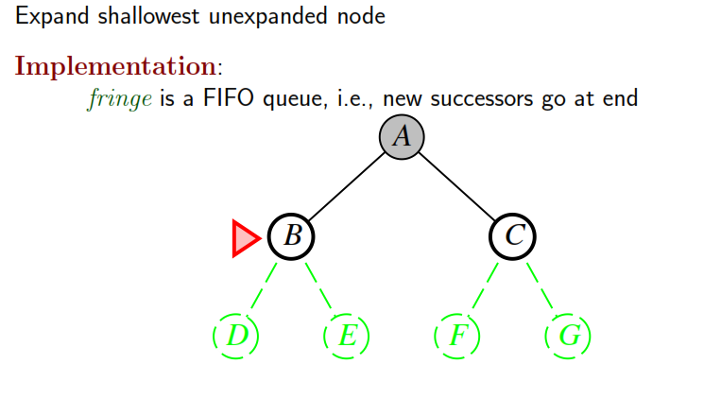
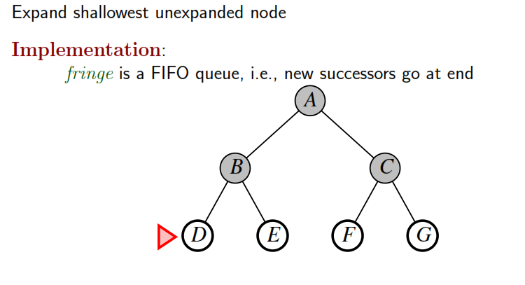
BREADTH FIRST SEARCH

Slide 11
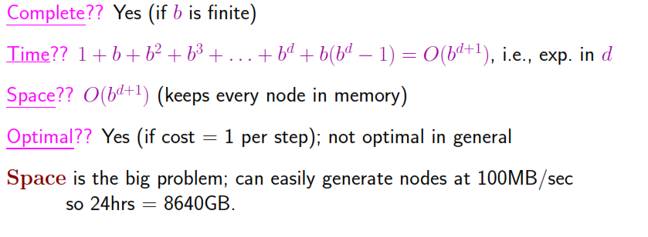
PROPERTIES OF BREADTH FIRST SEARCH

Slide 12
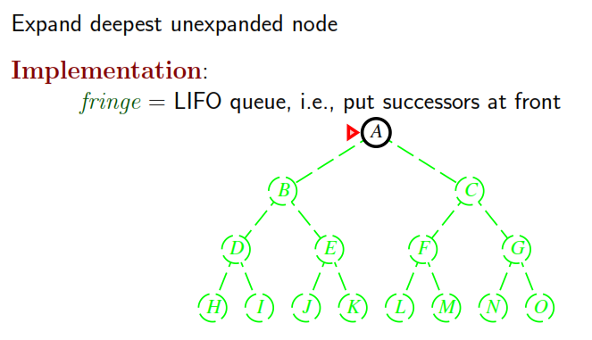
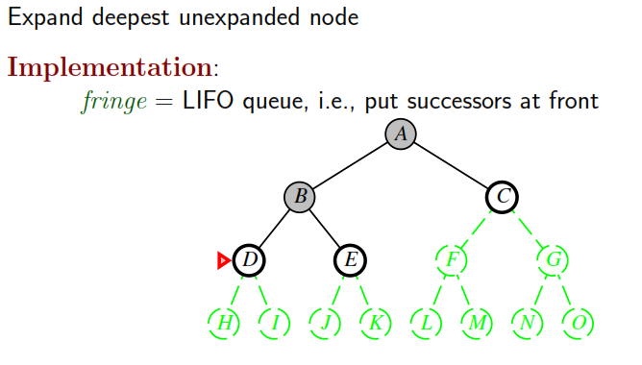
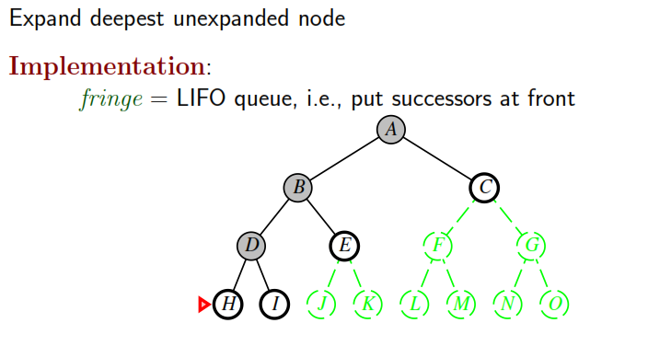
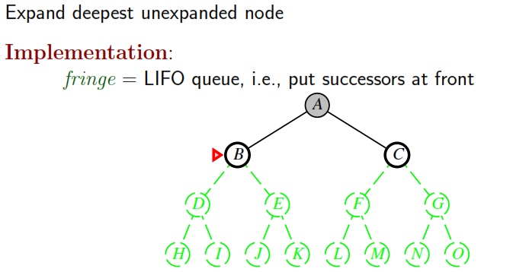
DEPTH FIRST SEARCH

Slide 13
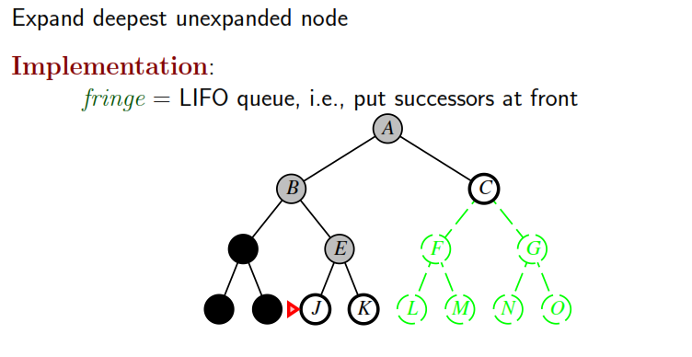
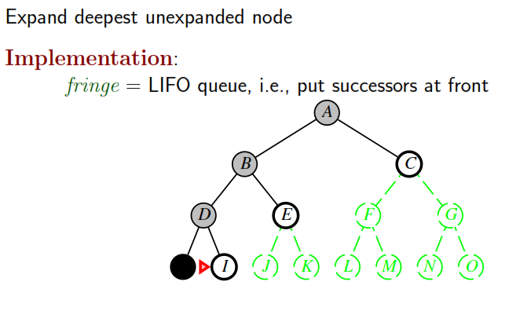
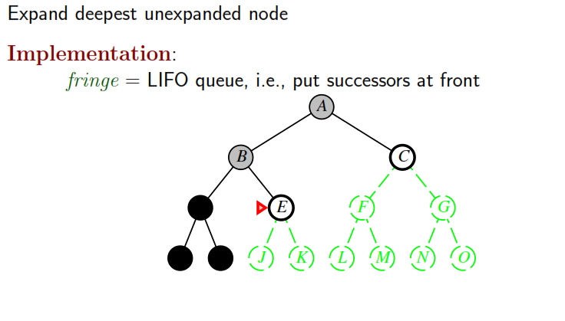
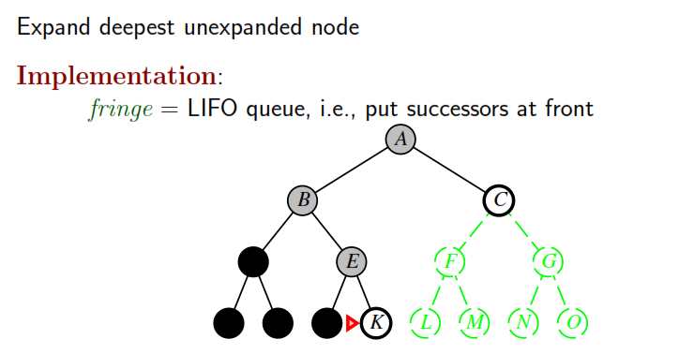
DEPTH FIRST SEARCH ( Contd. )

Slide 14
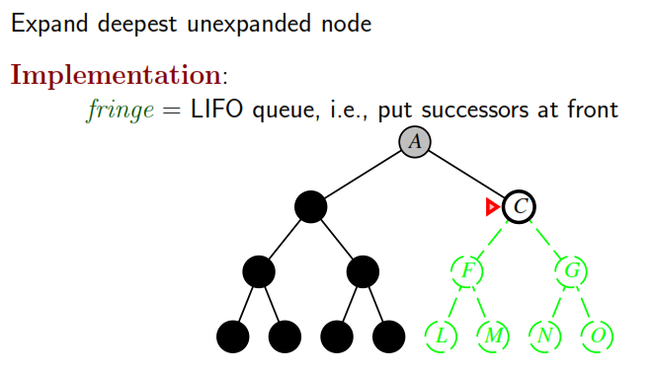
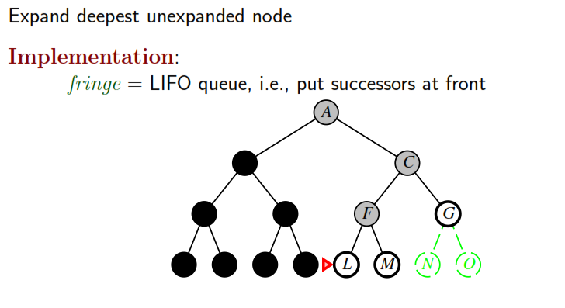
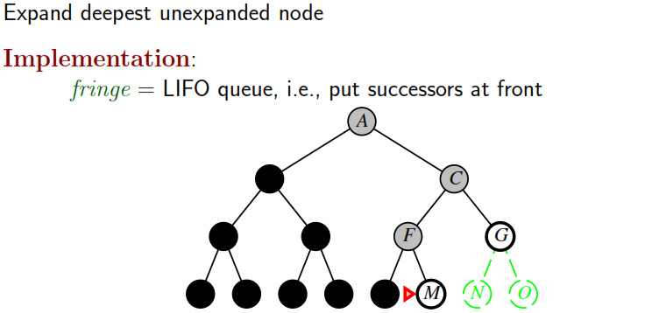
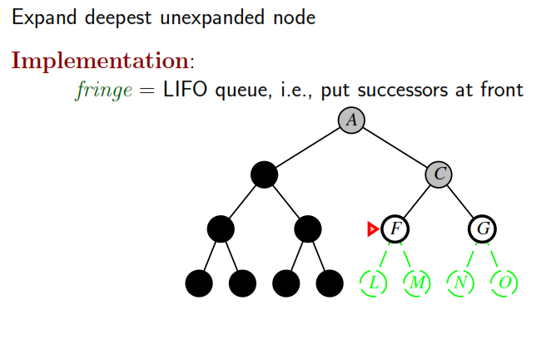
DEPTH FIRST SEARCH (Contd. )

Slide 15
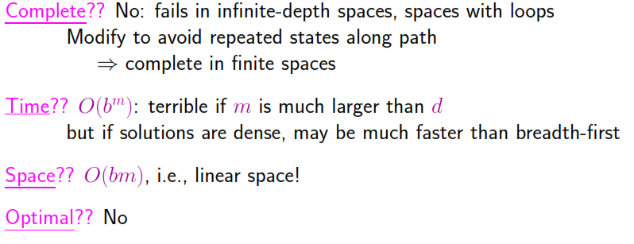
PROPERTIES OF DEPTH FIRST SEARCH

Slide 16
SEARCHING WITH PARTIAL INFORMATION
Sensorless Problems ( Conformant Problems )
Agent could be in any of possible initial states and each action has several possible successor states
Contingency Problems
If environment – partially observable / if actions are uncertain, then agent’s percepts provide new information after each action. Problem – Adversarial if uncertainty is caused by actions of another agent.
Example of contingency problem ( with vaccuum cleaner ) : Explanation
Exploration Problems
States and actions of agents – unknown. Agent must act to discover them

Slide 17
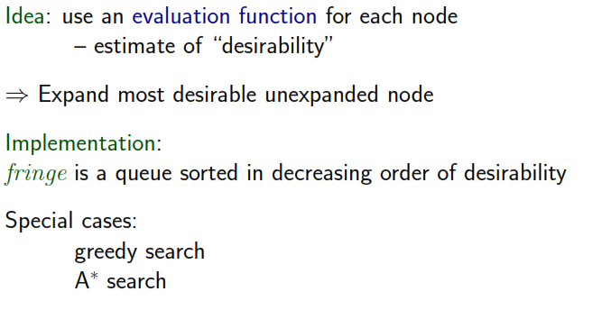
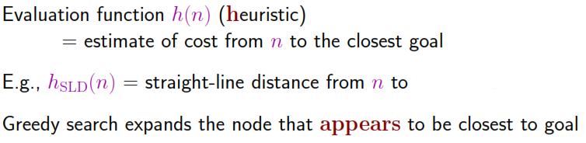
BEST FIRST SEARCH

Slide 18
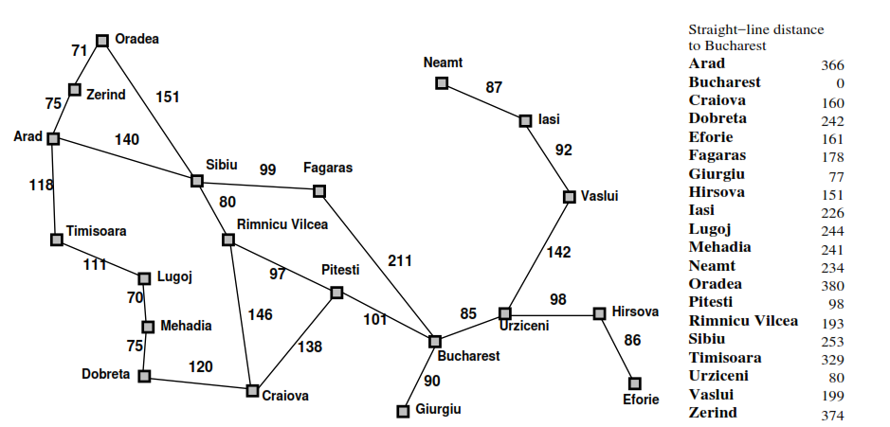
MAP

Slide 19

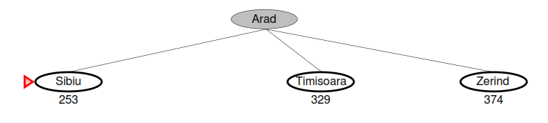
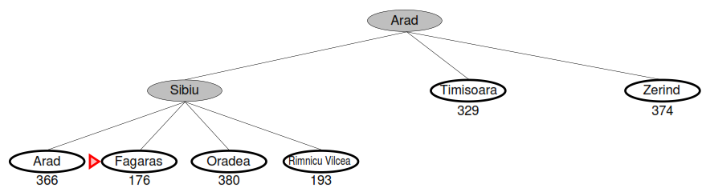
GREEDY SEARCH - Example

Slide 20
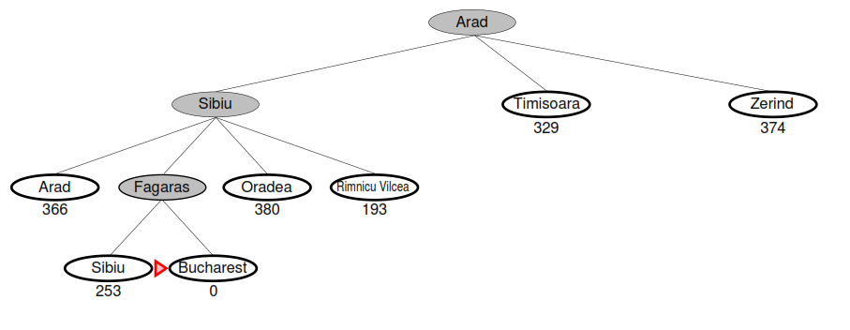
GREEDY SEARCH – Example(Contd.)

Slide 21
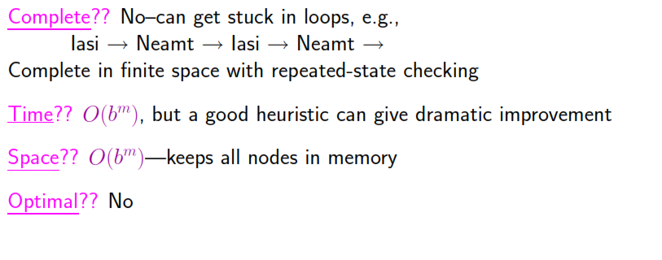
PROPERTIES OF GREEDY SEARCH

Slide 22
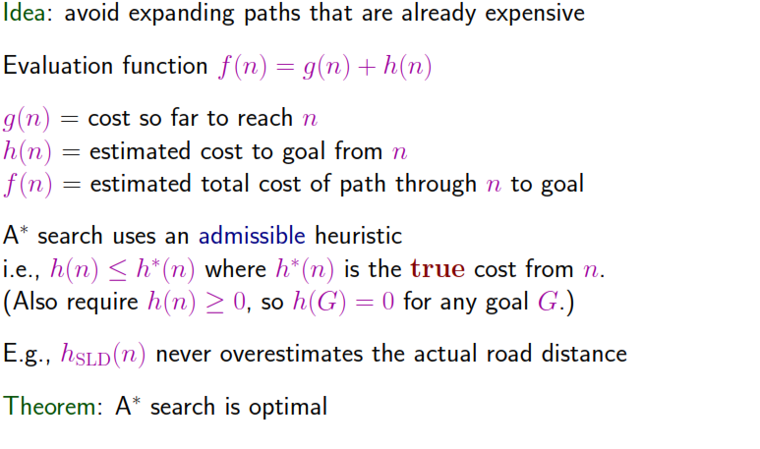
A* Search

Slide 23

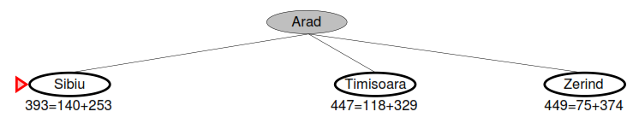
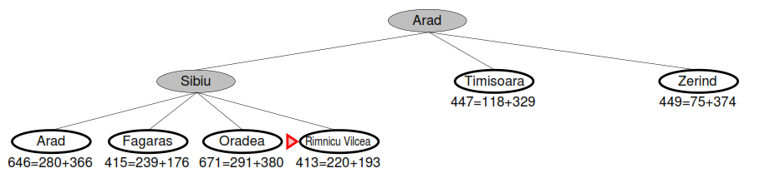
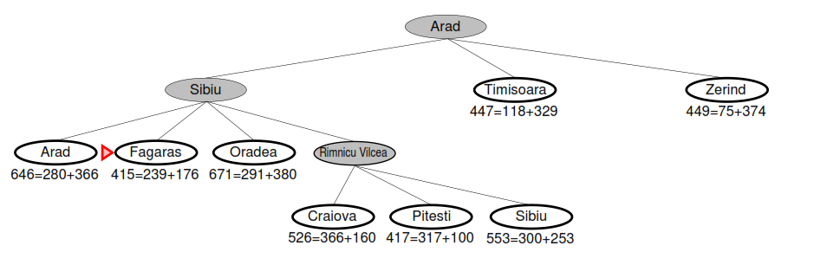
A* SEARCH - Example

Slide 24
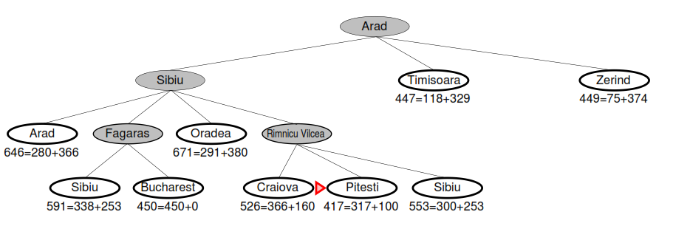

Slide 25
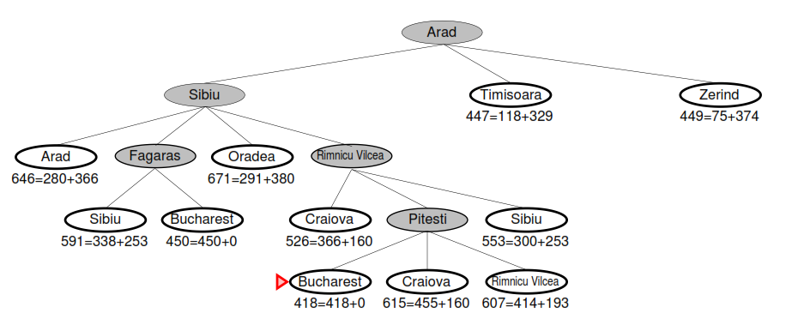
A* expands nodes in form of increasing f value

Slide 26
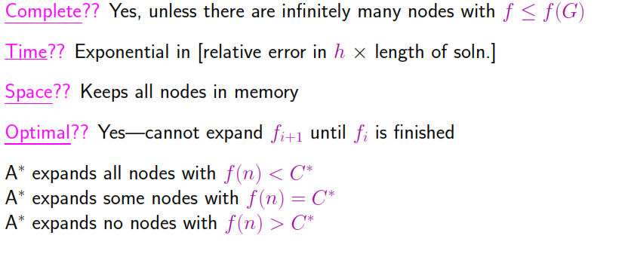
PROPERTIES OF A*

